Slide 1
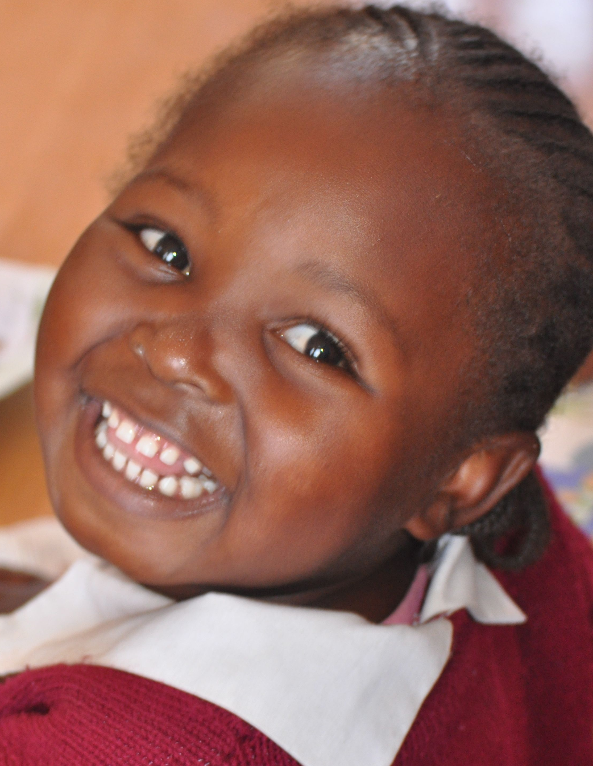
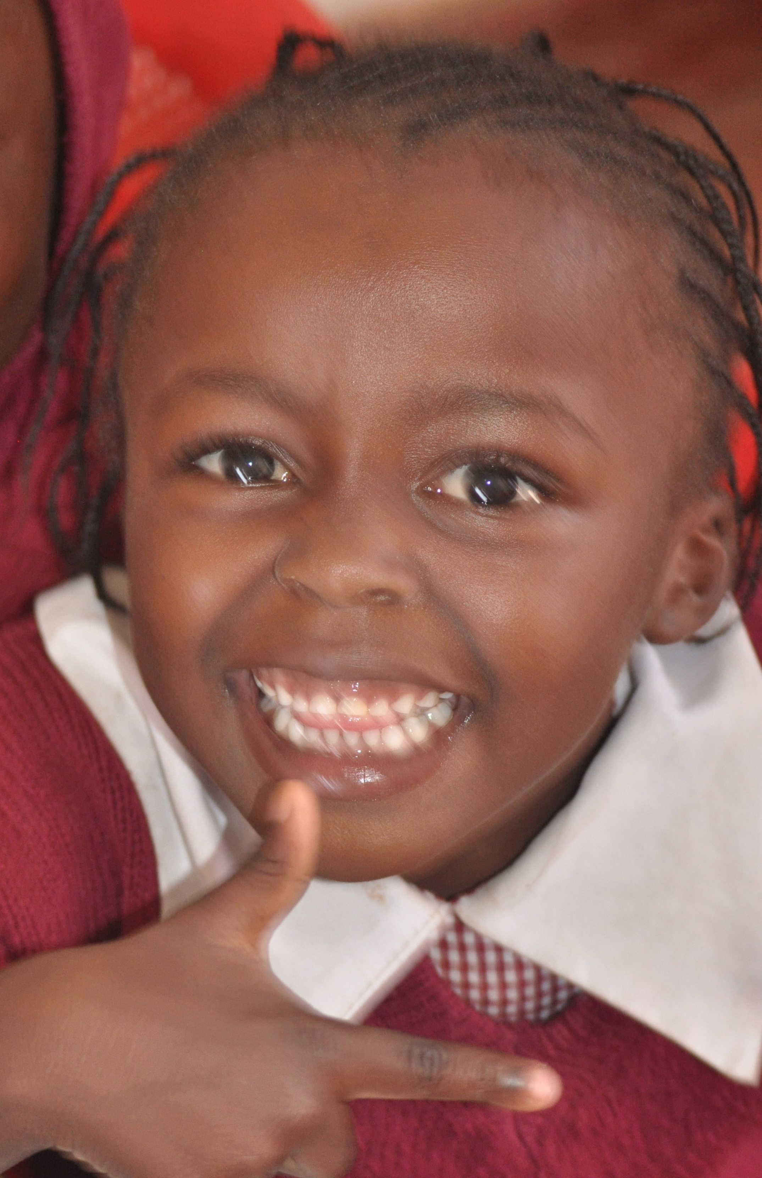
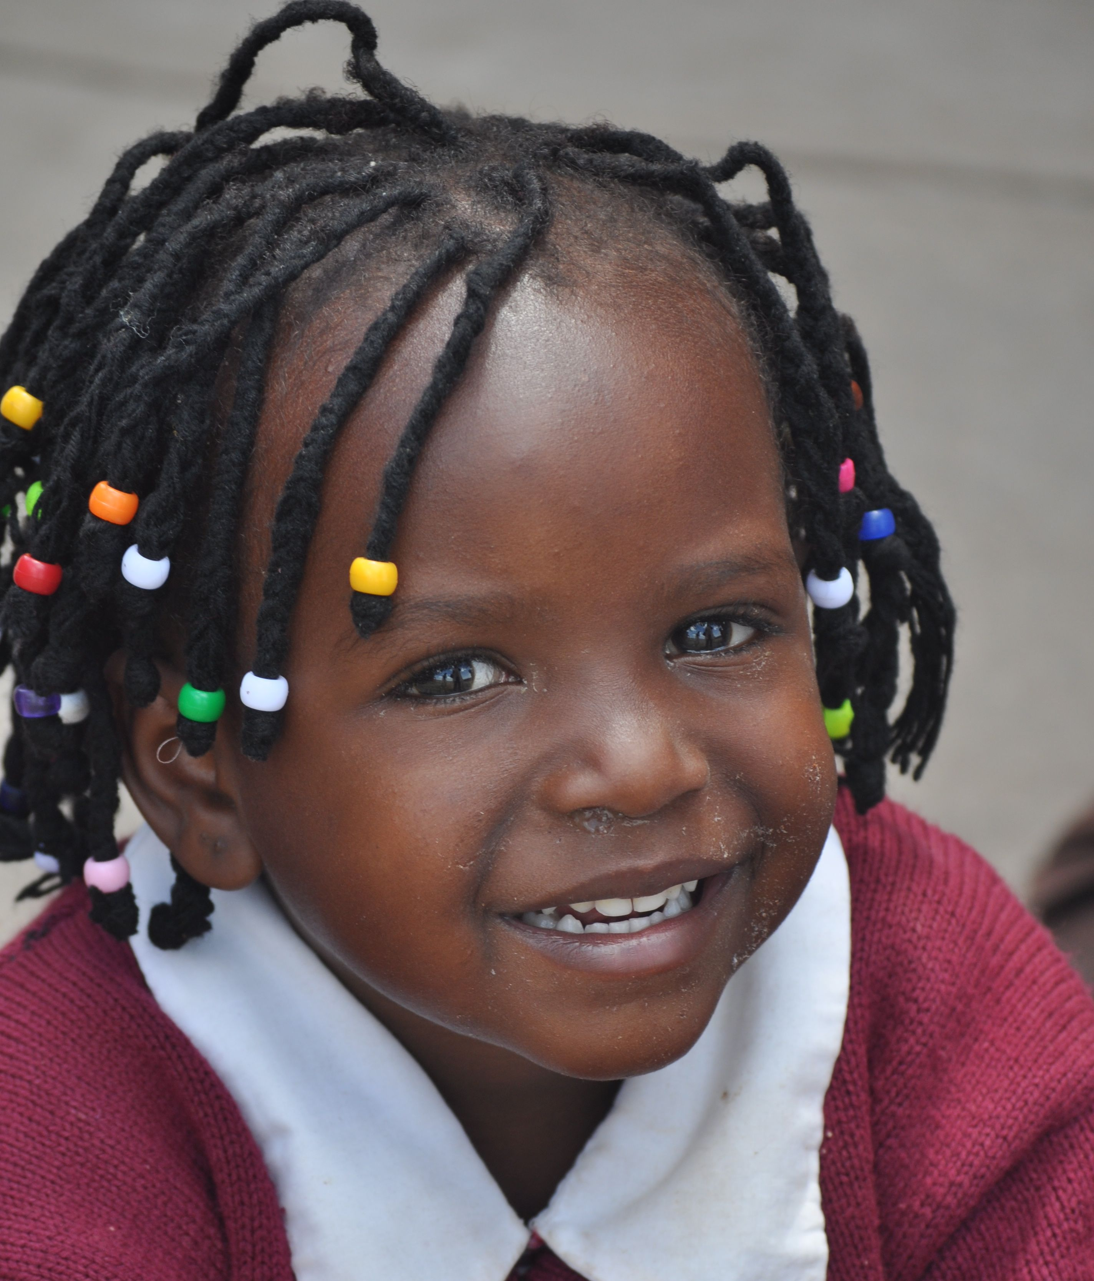
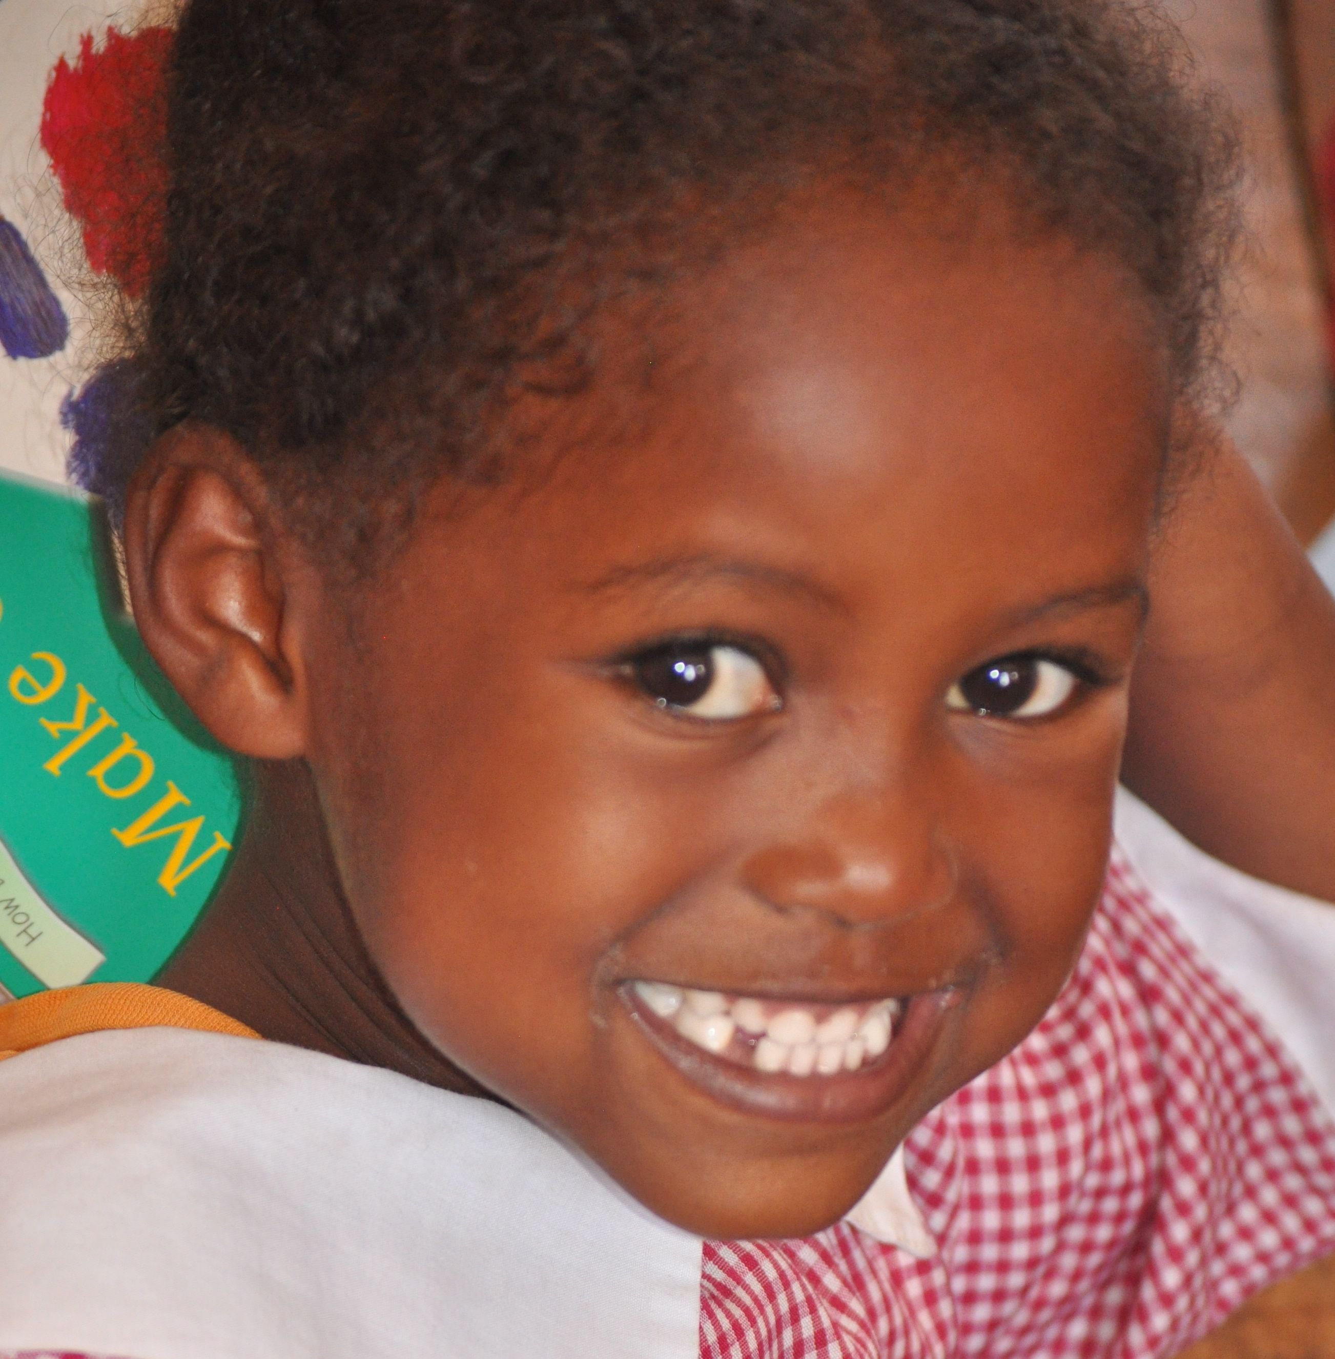
KENYA SMILES
Improving The Oral Health of Children in Kenya
An Introduction to Good Oral Health
A Classroom Lesson for Young Children
With the distribution of Kenya Smiles backpack
Kenya Smiles Vocational Training Team, Kenya, July 2013

Slide 2
MATERIALS
Photo of healthy teeth of a child
Photo of healthy teeth of an adult
Photo of unhealthy teeth of a child
Large Tooth Model and Toothbrush http://www.xump.com/Science/OralHygieneModel.cfm
Hand Puppet of Hippo http://www.folkmanis.com/Prod-67-1-212-1/Hippo.htm
Photo of how much toothpaste to use
Healthy food/not-healthy food Tooth Board http://practicon.com/Tooth-Friendly-Snacks-Magnetic-Board/p/41-14712/
Lyrics for The Tooth Song: (Tune of Twinkle Twinkle Little Star)
Backpack with Colgate dental care supplies for each child
Sharpie pens for children to use to write their names on their backpacks
Time
25 – 30 minutes depending on age, group size, and participation of translator(s)
plus distribution of backpacks.

Slide 3
INTRODUCTION
Introduction of presenters including translators if present.
We’re here to talk with you about an important part of your body.
Your teeth! Please show us your big smiles.
We have a lot to talk about, so when we ask a question, please raise your hand, and we’ll call on different children to answer.
If you have questions or stories to share, please wait until we’re finished so we’ll have time to listen you.
Ready?

Slide 4
LESSON
Here’s the first question. Please remember to raise your hand if you have an answer.
Why do we have teeth?
To eat, chew our food
To speak
To smile
Show us your lovely smiles again.
How do we keep our smiles lovely and our teeth healthy?
Brush
Eat healthy foods
Rinse with water after eating
How many sets of teeth do we get?
2
Baby teeth/milk teeth/primary teeth
Adult teeth/permanent teeth/grown up teeth
How many baby teeth do we get?
20
Photo of healthy teeth of a child.

Slide 5
Why do we lose our baby teeth?
To make room for our adult teeth
Because we need bigger, stronger teeth to last the rest of our lives.
How many adult teeth do we get?
32
Photo of healthy teeth of an adult.
Adult teeth can last for our whole adult life if we take good care of them.
Why is it important to take care of our teeth?
Healthy teeth and mouth are part of a healthy body
For a nice smile
Various answers
Do everyone’s teeth always stay strong and healthy?
Not always
What can happen to teeth so they are not healthy?
Get cavities
Get broken
Get knocked out
Various answers

Slide 6
What is a cavity?
Small hole in a tooth
Photo of unhealthy teeth of a child
What causes a cavity?
Eating food that is not-healthy
Not brushing
Sugar bugs
Other answers
What are sugar bugs?
A sticky, fuzzy, clear film on our teeth
Where do sugar bugs come from?
Various answers
How do you make sugar bugs go away?
By brushing and rinsing them away
Let’s talk about how you can take good care of your teeth

Slide 7
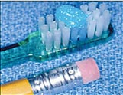
TOOTH MODEL and TOOTHBRUSH
TOOTHBRUSH
Demonstrate how to brush
Brush 2x’s/day for 2 minutes each time
Brush in small circles
Be gentle, not rough. Do not scrub.
Brush the teeth and the gums where sugar bugs like to hide
Brush all surfaces of the teeth: inside, outside, the side you chew with, top and bottom
Don’t forget to brush your tongue! Sugar bugs like to hide there too.
After you are done brushing, swish water in your mouth and spit it out. Do not swallow it.
If you did a really good job, your teeth will look and feel clean!
TOOTHPASTE
How do you use toothpaste?
Various answers
Photo of how much toothpaste to use
Remember that toothpaste is not food, so don’t eat it
What do you do if you run out of toothpaste?
Still use your toothbrush with water to get the sugar bugs off
If you don’t have a toothbrush, you can rinse your teeth

Slide 8
HEALTHY FOOD/NOT-HEALTHY FOOD TOOTH BOARD GAME
Not-healthy foods stick to teeth
Healthy food falls off
Sugar bugs stick to not-healthy food
“Treat” means not all the time but sometimes
When we do have a treat, we know to brush our teeth or rinse our mouths
Let’s play the game. When we show you one of the foods,
If you think is not-healthy, that it will stick to the tooth, raise your hand.
If you think it is healthy, that it will not stick to the tooth, show us your big smile.

Slide 9
REVIEW and CONCLUSION
REVIEW
Why do we have teeth?
How many sets of teeth do we get?
How many baby teeth do we have?
Why do we lose our baby teeth?
How many adult teeth do we get?
Why is it important to take care of our teeth?
How can we keep our teeth healthy?
CONCLUSION
Thank you for listening so carefully.
We hope you’ll take very good care of your teeth.
Let’s sing a Tooth Song: (Tune of Twinkle Twinkle Little Star)
“Get my toothpaste, get my brush
I won’t hurry, I won’t rush.
“Making sure my teeth are clean
Front and back and in-between.
“When I brush for quite a while
I will have a happy smile

Slide 10
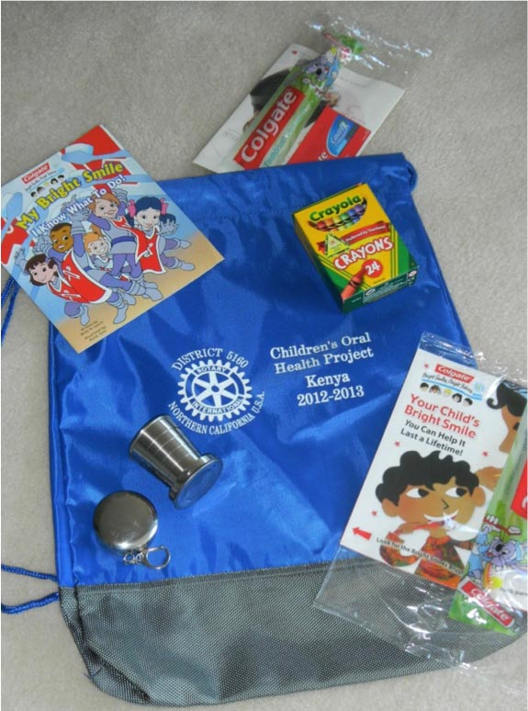
BACKPACKS
Now we have a special gift for you to help you keep your smile healthy.
We have enough backpacks for each of the children in the group today.
Let’s see what’s in the backpack.
Show contents
Distribute backpacks with help of principal, teachers, parents, and other adults
Pass around Sharpie pens for children to write their names on backpacks
Collect sharpie pens.
Thank principal, teachers, children, and parents if present.

