Slide 1


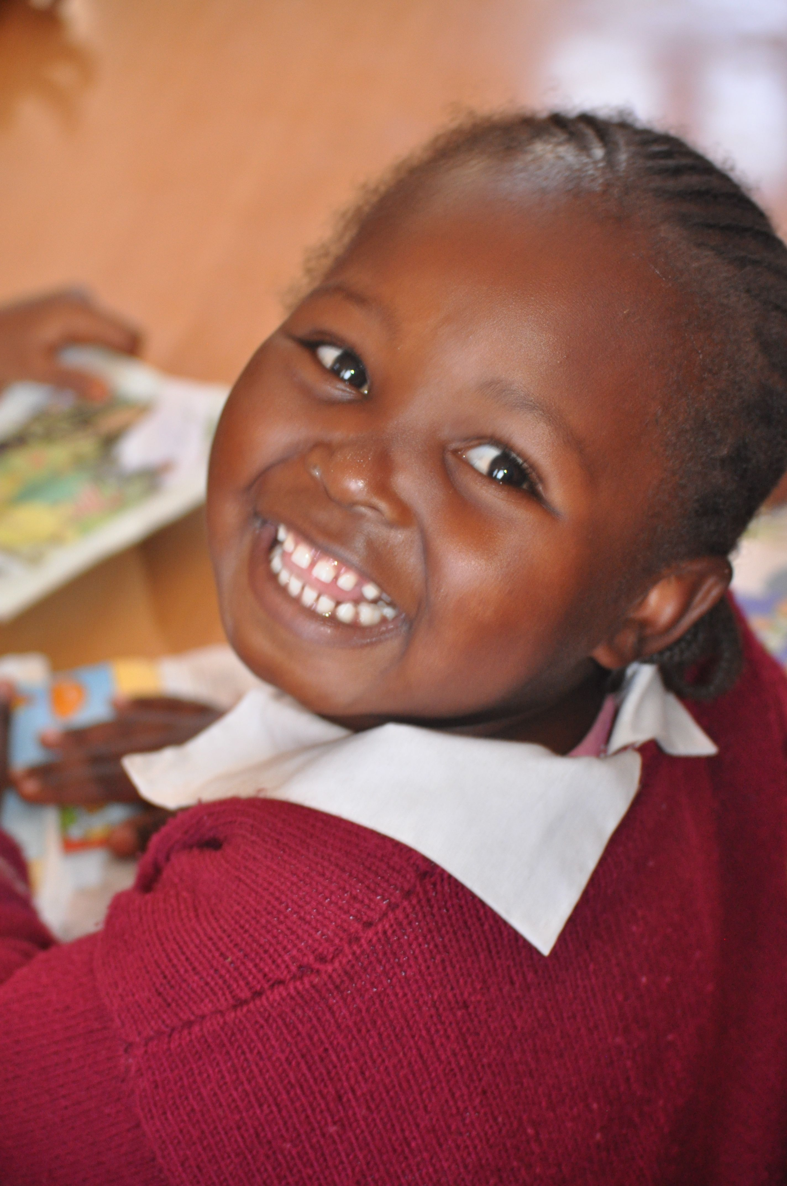

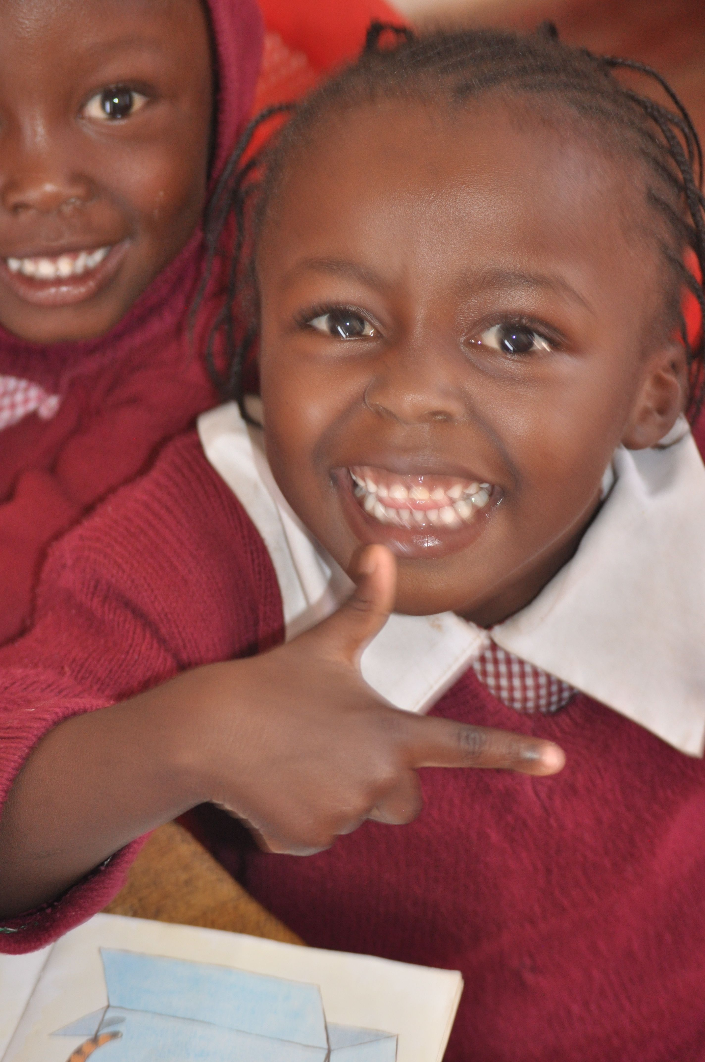
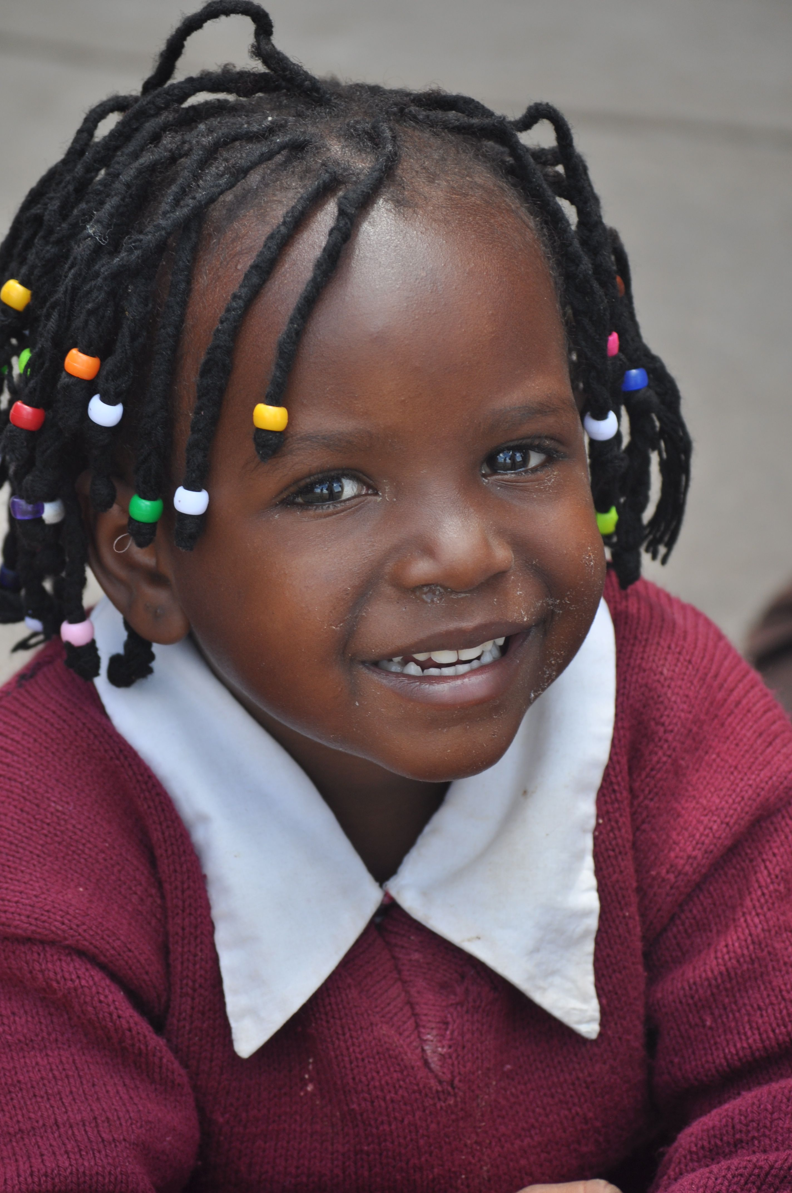


KENYA SMILES
Improving The Oral Health of Children in Kenya
An Oral Health and Nutrition Tool Kit
For Health Workers, Teachers, Parents, Caregivers, and Children

Slide 2
A HEALTHY MOUTH
Activities:
Tell us about a person you know with good teeth and another person with dental problems.
Draw the smile you want.
Drama: “What happens when a decayed baby tooth falls out too early?”
4 children act as baby teeth and stand in front, and 4 children act as permanent teeth and stand in back.
The 2 baby teeth in the middle have cavities and fall out too early, the 2 baby teeth next to them move in closer, and the 2 permanent teeth in back try to come forward. There is not enough space, so they enter crooked. What are the consequences of losing a tooth?
Lesson: Baby teeth are the first teeth. They come in when the
baby is 6 months old and remain until 12 years of age.
Why are baby teeth important? They are required to:
Eat
Talk
Smile
Have good health
Save space for permanent teeth
Feel happy, beautiful and proud
More Information: The mouth is the gateway to the body. It is important to keep it clean and healthy to protect your health.
If you don’t care for your oral health, it can cause the following diseases:
Infections in the mouth – tooth decay, abscesses
Malnutrition and poor growth
Diarrhea
Pneumonia
Heart disease
Rarely, death

Slide 3

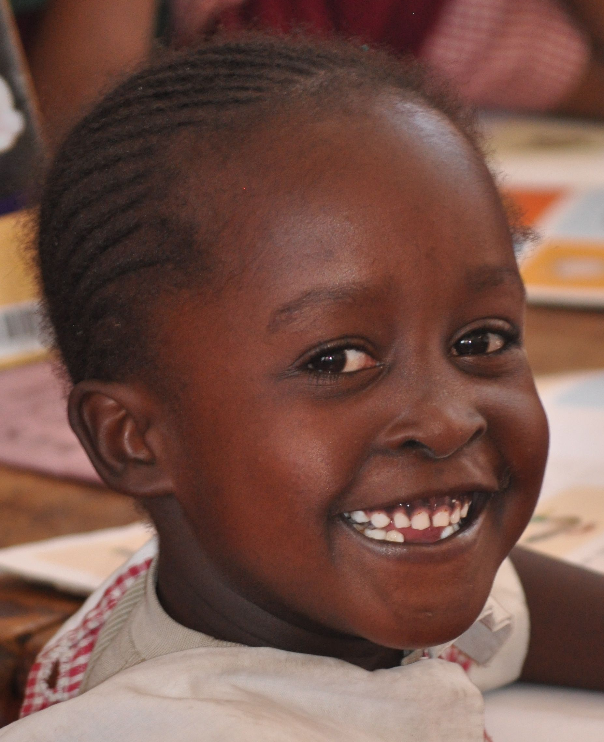
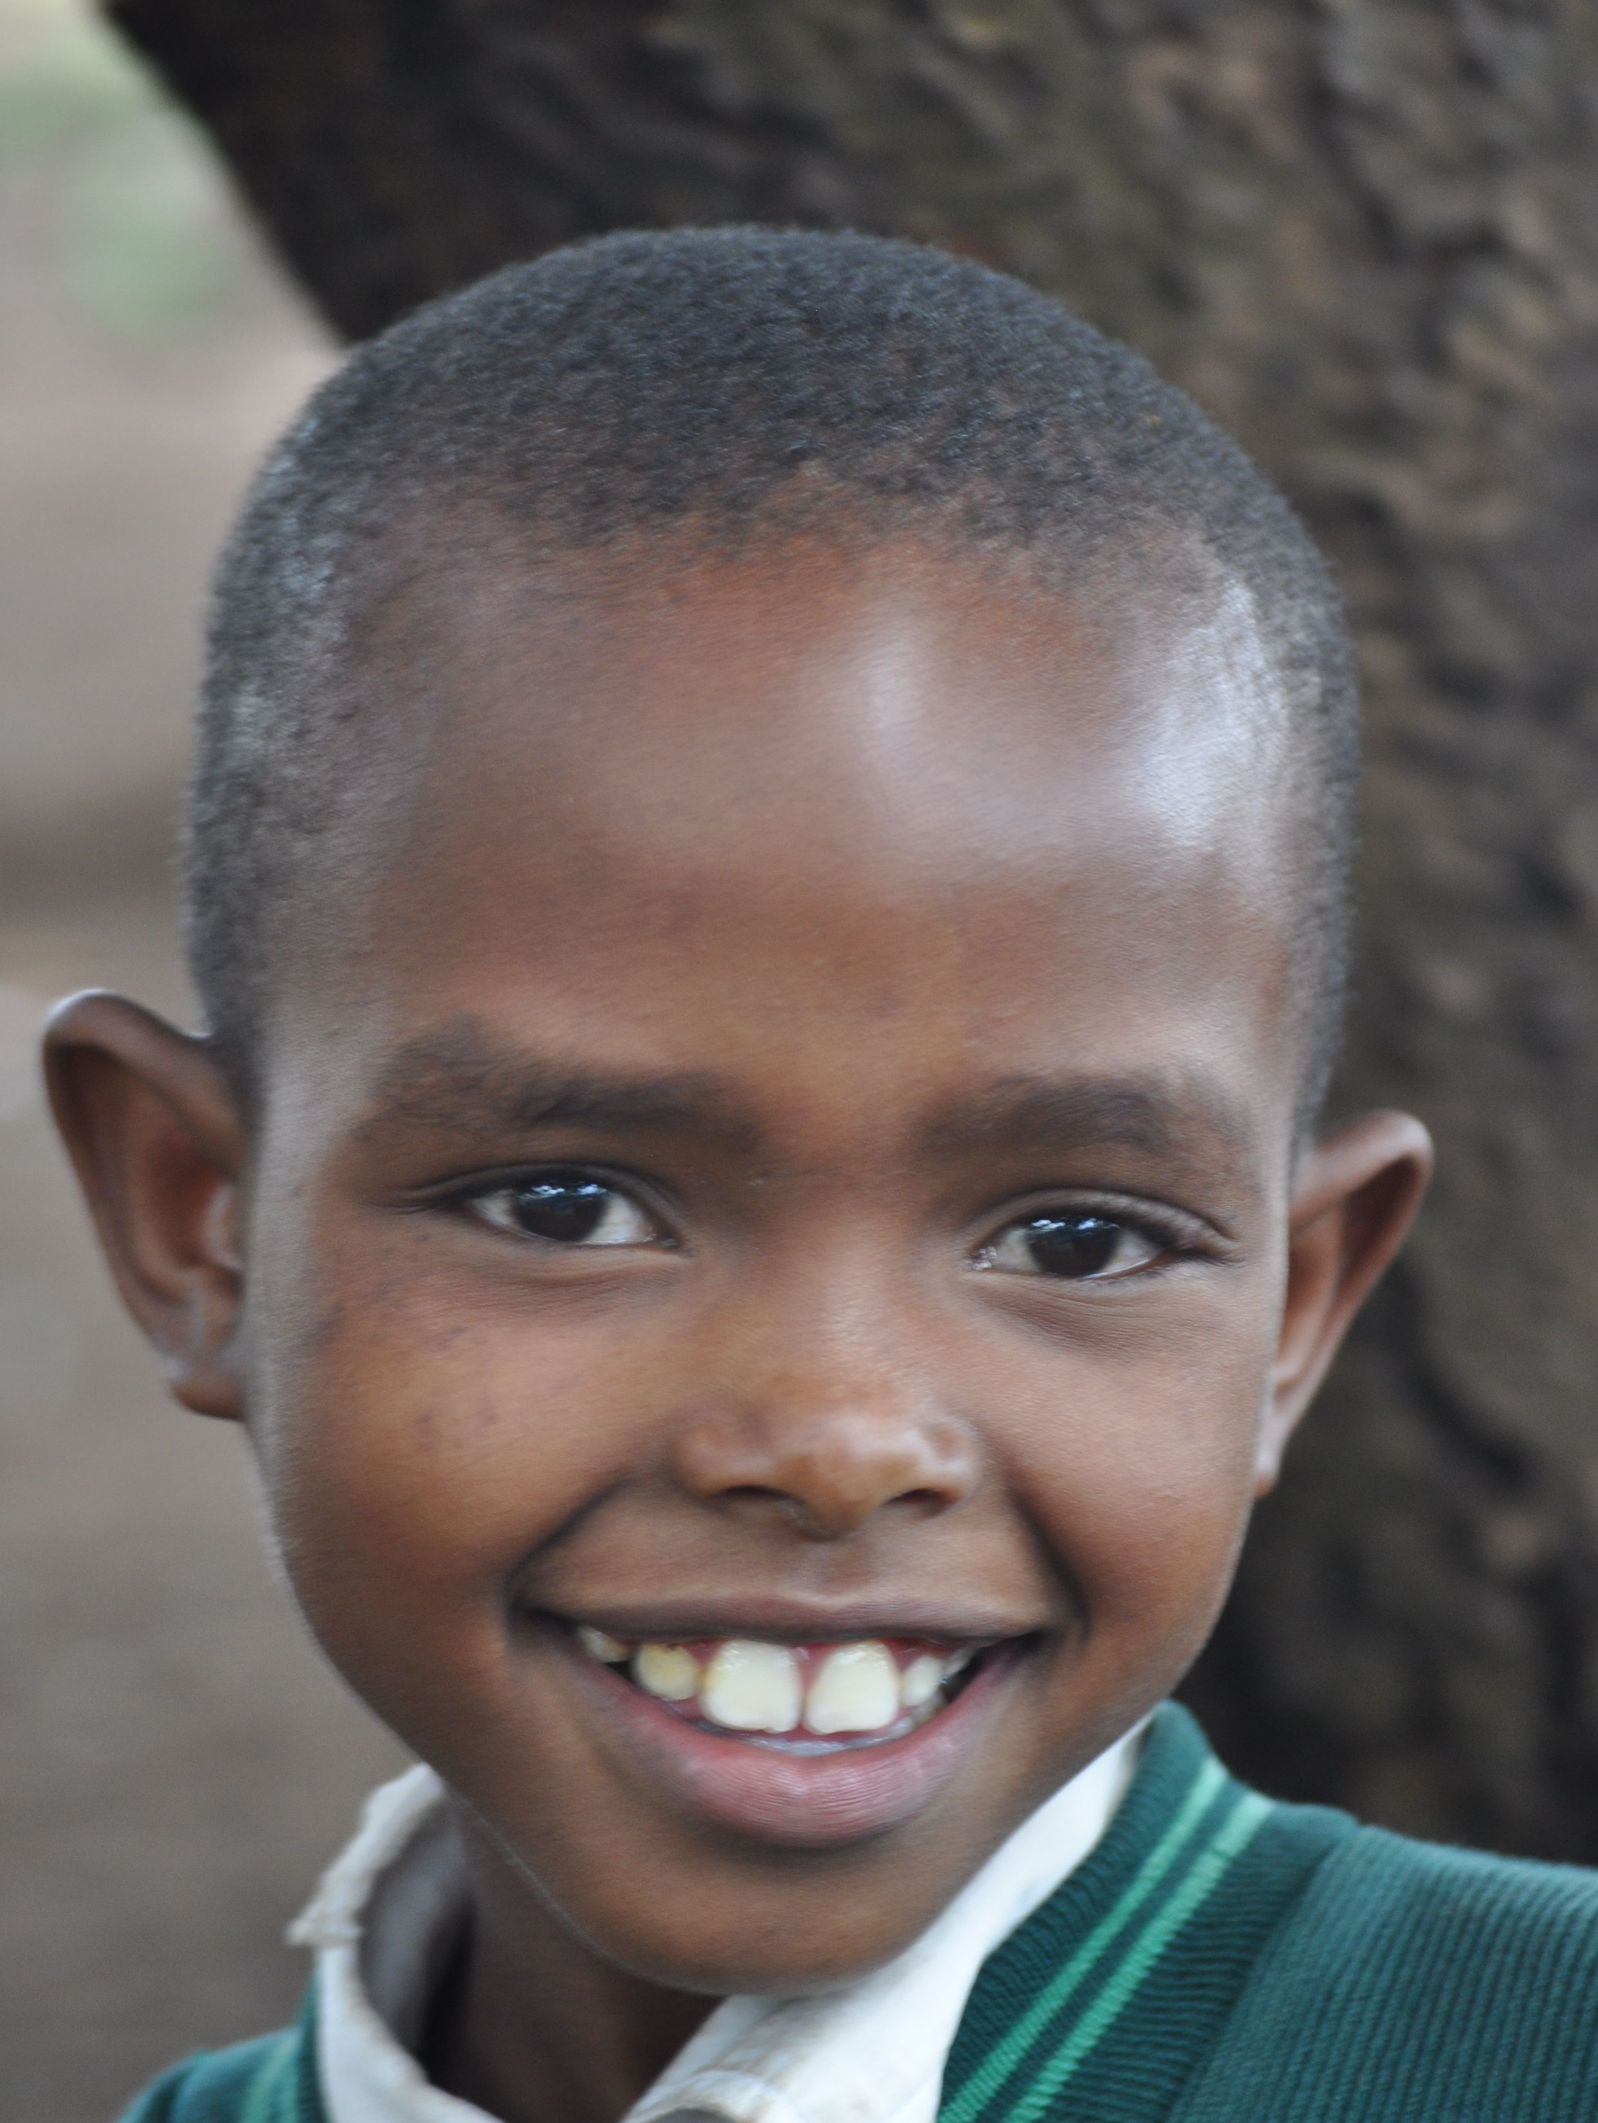

A HEALTHY MOUTH

Slide 4
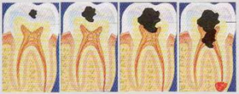

TOOTH DECAY
Activity:
Demonstrate tooth decay with a boiled egg for each child.
The egg represents a tooth. The outside of the tooth is hard. With the pencil, draw a line and show that it is still hard. Strike the shell hard with the point of the pencil to make a hole – the cavity is starting. Make the hold bigger. The teacher puts a drop of ink in the hole – this represents the tooth decay. Then peel the egg, and cut the egg in half, showing that the yolk is like the pulp or inside of the tooth – Tooth decay has reached the pulp, and causes a lot of pain.
Lesson: Tooth decay is the most common disease in children.
In the photos on the following page you see:
Tooth decay begins as white spots on the teeth. The spots do not hurt and they can heal.
Tooth decay can become worse as dark spots and holes (or cavities) in the teeth. Sometimes, the child may suffer from pain. The child needs dental treatment.
If the child does not receive dental treatment, the tooth decay can become worse. The tooth can break and fall out. The infection enters the root of the tooth, the nerve and the bloodstream. The child can suffer from a lot of pain. It is difficult to eat, sleep, play and study. The child needs urgent dental treatment.
More Information: Tooth decay can begin when the baby teeth come into the mouth. Generally, tooth decay starts in the front teeth and molars, and then spreads to the other teeth. The infection can damage the permanent teeth and they may come in crooked. If you take care of baby teeth, you can prevent tooth decay, mouth pain and other health problems.

Slide 5
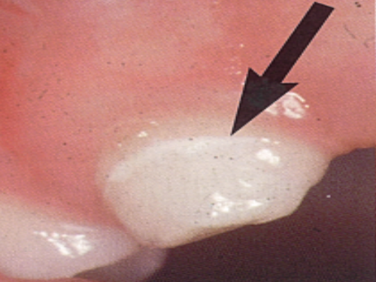
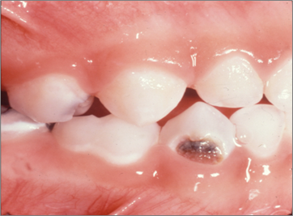
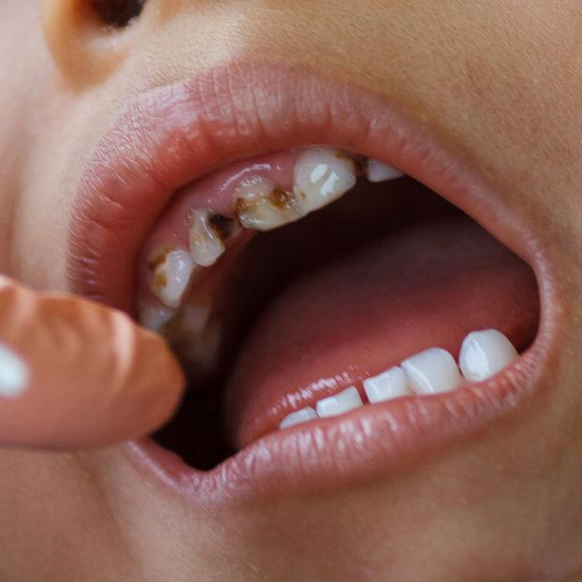
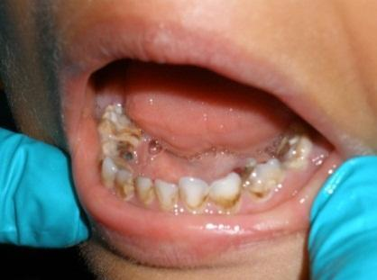
TOOTH DECAY

Slide 6
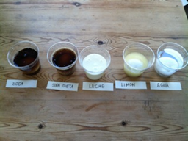
HOW TOOTH DECAY HAPPENS
Activity:
Demonstrate how drinks can damage teeth.
5 boiled eggs, 5 glasses
1 glass with soda, 1 diet soda, 1
with lemon juice, 1 with milk,
and 1 with water.
Put an egg in each glass. Wait a few days and look at the shell. Take the egg out of the liquid, look at it and touch it. Both types of soda and lemon juice make the shell softer with less protection. The same happens with teeth.
Lesson: There are bacteria in the mouth that we can’t see. The bacteria eat the sweet food and drinks that come into our mouth. If there are lots of sweets in the mouth, the bacteria have a party and produce acid – this is like a fire that attacks the teeth. Every time you eat something sweet, there is an acid attack that damages the teeth, little by little. Cavities begin as spots, then make dark holes in the teeth, and eventually you can lose your teeth.
More Information: Where do the bacteria come from? Babies are born without the bacteria that cause tooth decay. The bacteria passes to the baby’s mouth from the mouth of adults and other children. How do we pass the bacteria?
Sharing utensils, cups and straws
Sharing food and drinks
Tasting or pre-chewing food for a baby
Sharing a toothbrush
Cleaning a pacifier with saliva
Kissing the baby on the mouth
Try not to spread bacteria and take care of the teeth to remove the bacteria.

Slide 7
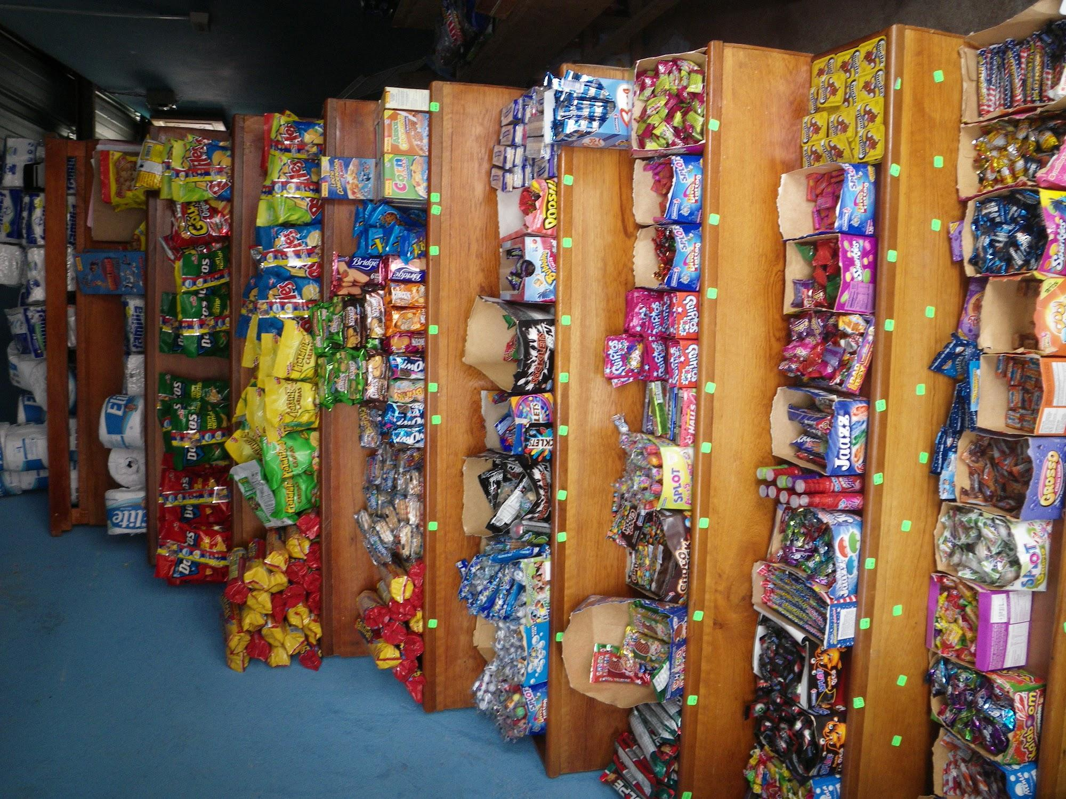

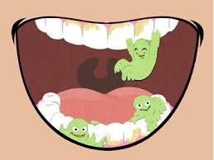
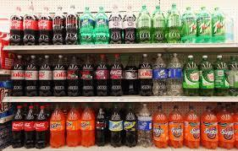
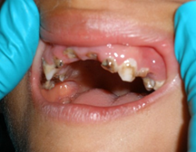

HOW TOOTH DECAY HAPPENS

Slide 8
YOU CAN PREVENT TOOTH DECAY
Activities:
1. Ask your grandparents:
What did they what when they
were children?
How did they get their daily
food?
What were their favorite snacks?
What did they drink?
2. Ask your parents the same
questions.
3. Answer the same questions
based on your experience.
What are the differences?
What are the similarities?
What has changed?
What has not changed?
What are the consequences?
Lesson: You can prevent tooth decay completely. Children do not have to suffer from cavities. You just have to do 3 things:
Good Nutrition: Children need healthy natural food to grow strong and healthy. Our ancestors knew that the good food was the traditional food that they planted and cooked. Now many foods and drinks are sold in stores that have sugar and artificial chemicals – they are not healthy for children.
Tooth Brushing: Even though you cannot see the bacteria that cause tooth decay, you can remove them by brushing your teeth every day.
Dental Treatment: Your dentist can check your teeth and apply fluoride varnish and sealants to protect the teeth.
More Information: In recent decades, the big change in nutrition has caused epidemics of tooth decay, obesity, cardiovascular diseases and diabetes. Good nutrition can help prevent all of these diseases.

Slide 9


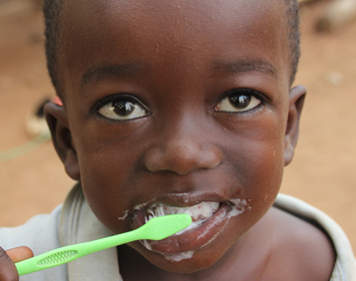
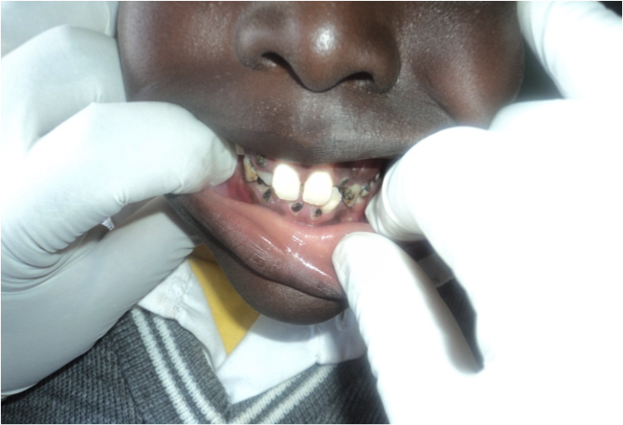
YOU CAN PREVENT TOOTH DECAY
Good Nutrition
Tooth Brushing
Dental Treatment

Slide 10
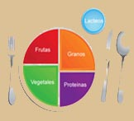
GOOD NUTRITION
Activities:
Snacks: In a basket, bring examples of healthy foods and drawings of different snacks. On 2 tables put signs: “Healthy Food” and “Unhealthy Food”. Each child pulls out of the basket a food or drawing. The child explains where the food comes from, whether it is a healthy or unhealthy food, and if it’s good to eat every day or just occasionally. Then the child puts the food on the correct table.
Meals: Small drawings of different healthy foods. Three large pictures of this dish with signs: Breakfast, Lunch, and Dinner. Hand out a picture of a food to each child. Tell them, “Let’s make breakfast. Who has something for the plate? Invite children to attach their food in it proper place on the plate. Then, “Let’s make lunch. Who has something for the plate? Finally, “Let’s make dinner. Who has something for the plate?”
Lesson:
Healthy Foods: They are natural and fresh foods that we harvest (e.g. milk, cheese, corn, cassava, meat, chicken, fish, palm hearts, beans, plantains, rice, squash, papaya, mango, tomato, cucumber, pineapple, eggs). They are good to eat every day.
Unhealthy Foods: These are processed foods with added sugar and chemicals. They come in packages, bottles, or cans (e.g. soda, candy, cookies, chips, chocolate, lollipops, junk food, ice cream, sugary cereals). It is best not to eat them every day - only occasionally.
More Information: For babies – breast milk is the main food. If you have to use a bottle, put in only formula or milk, no sweet drinks and do not put your baby to bed with a bottle because it damages the teeth.
There are 5 types of healthy foods. It’s good to eat them at every meal.
Dairy products (milk and cheese) – they make strong bones and teeth
Grains (corn and rice) – they give energy
Proteins (meat, fish, eggs, and beans) – they help build muscles and a strong body
Vegetables (pumpkin, cassava, spinach)
Fruit (bananas, papaya, mango) – they have vitamins and minerals that make the blood, nerves, muscles and the entire body work well.

Slide 11
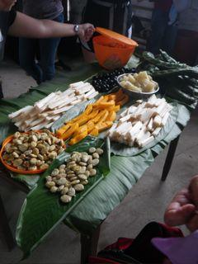
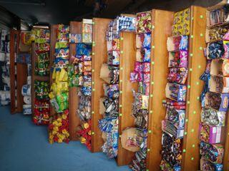

GOOD NUTRITION
HEALTHY FOOD
UNHEALTHY FOOD

Slide 12
TOOTH BRUSHING
Activity:
At school, after snack: Brush teeth with a song.
To the tune of the Alphabet Song or Twinkle Twinkle:
Girls and boys let’s keep our teeth
Shining for all to see.
Eat fruit, drink milk every day.
Brush those “sugar bugs” away.
Now let’s smile from ear to ear,
And let’s give a great big cheer –
YEAH! (Lots of noise, hooting, whistling, etc.)
To the tune of Happy Birthday:
Squeeze the past on the brush
Put the brush in your mouth
Brush your up teeth and your down teeth
Take your time. What’s the rush?
(Hum next verse while brushing):
Hmmmmmmmmm
Hmmmmmmmmm
Hmmmmmmmmm
(Then spit!)
Lesson: The bacteria hide between teeth. How can we remove them? You have to brush your teeth every day in the morning and before bedtime. It’s best for the whole family to brush together – that is how children learn, and the whole family is healthier.
How do you brush your teeth?
Use a brush with soft bristles
If there is toothpaste, put a little bit of paste on the bristles. If there is no toothpaste, it doesn’t matter.
Put the bristles between the teeth and gums. Make little circles, soft and slow. Sing and dance if you want. Start with the top and back teeth first. The bacteria and food hide there! Continue to the front and pass the brush slowly to the other side. Follow with bottom teeth next and slowly to the other side. Last, brush the tongue. Spit and don‘t rinse.
Fluoride: Fluoride makes teeth stronger and protects against cavities. There is fluoride in toothpastes and fluoride varnish.
More Information
For babies: Before teeth arrive, clean the gums with a clean cloth.
For children: Teach them how to brush their teeth and help them brush their teeth. Children need the help of an adult until they are 8 years old because they do not have the ability or patience to brush their teeth well.
Note – If your child has mouth problems like stained teeth, cavities or pain take them to the dentist for a checkup.

Slide 13
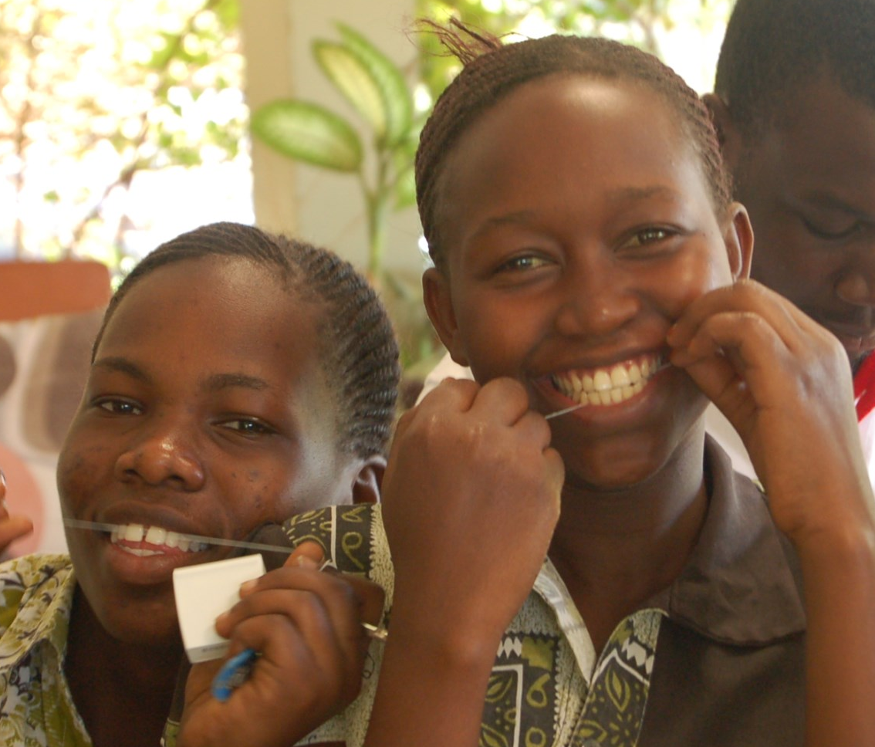
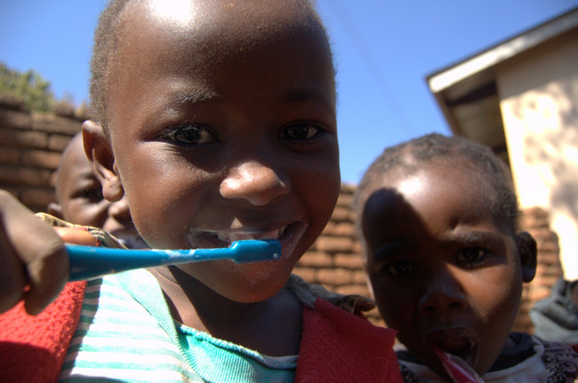
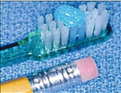

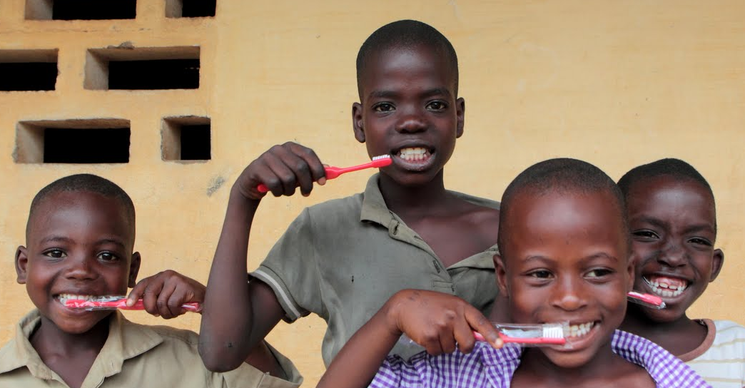

TOOTH BRUSHING

Slide 14
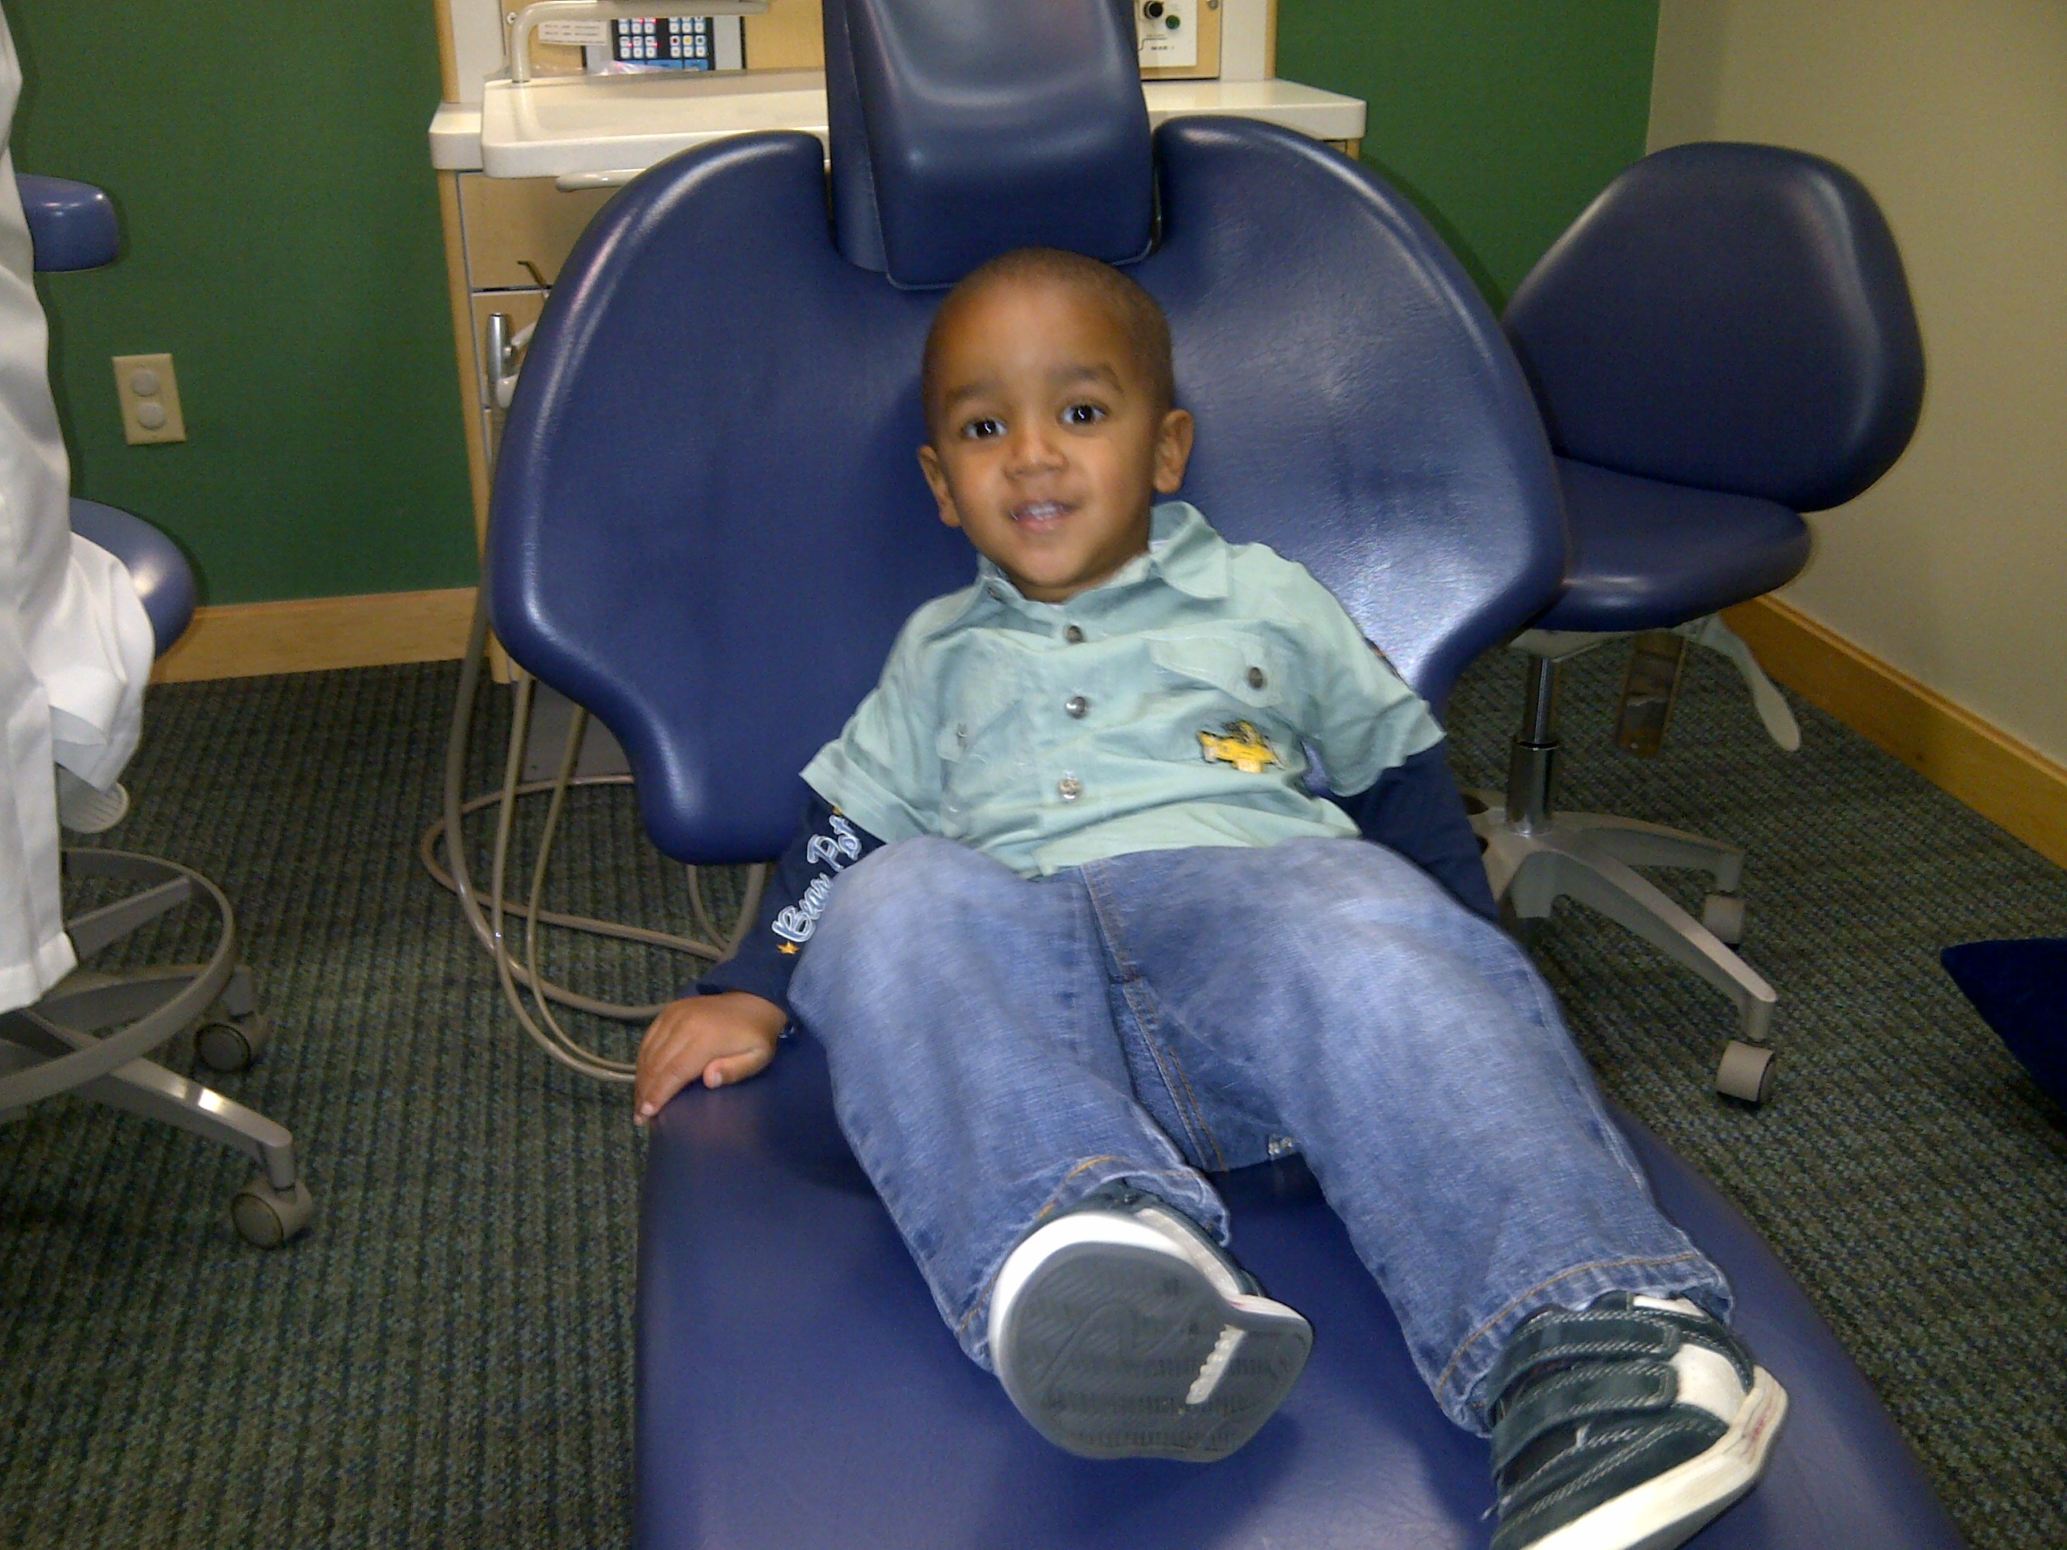
DENTAL TREATMENT
Activity:
Invite a dentist to your school to explain what a dentist does. The dentist can teach you about oral health and examine the children. The dentist can bring masks, gloves and flashlight.
Drama: Children get in pairs. One child plays the role of a dental assistant and helps the dentist to examine his/her partner. Then they switch places.
Take the class to the dental clinic to get to know the dentist and assistants.
Lesson: The dentist is your professional friend that can help prevent cavities and help you keep your mouth healthy. The dentist can give you a check up, teach you how to care for your teeth, put on fluoride varnish and sealants to protect the teeth, and do treatments if needed.
Fluoride Varnish: Fluoride is a natural mineral that makes teeth stronger and protects teeth against cavities. The dentist will paint your teeth with fluoride varnish 3 times a year. It is quick and painless.
Sealants: These are special dental materials that the dentist uses to cover the teeth and protect against cavities.
More Information: If you take your child to the dentist only when he/she has severe tooth decay and pain, your child will be afraid of the dentist. It is best to take your child to the dentist for a checkup to prevent cavities and treat them early so he/she doesn’t have pain or fear.

Slide 15
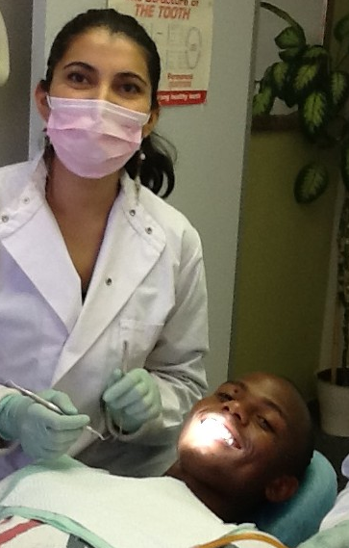
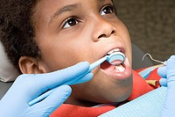
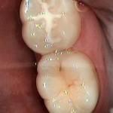
DENTAL TREATMENT

Slide 16
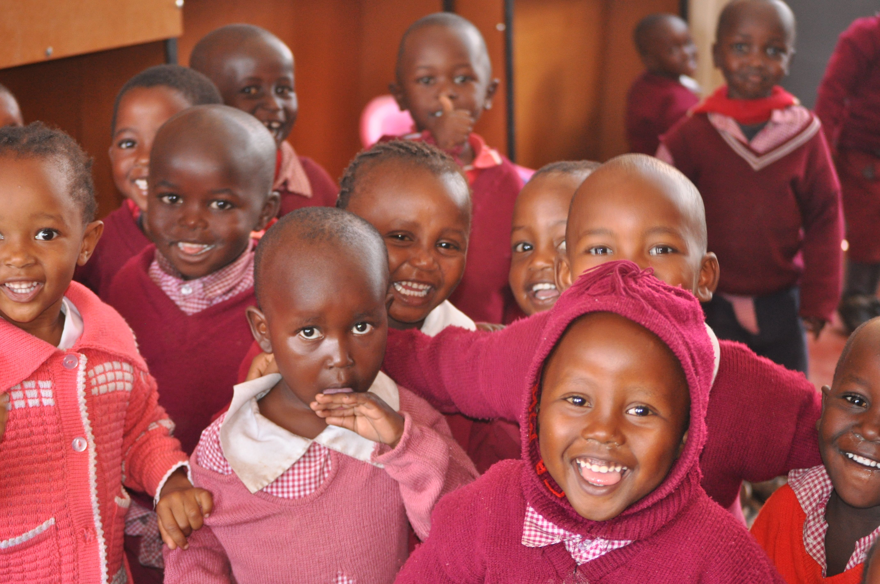
REMEMBER
Lesson: Baby teeth are important.
Activity:
Invite children to tell the story of healthy teeth and happy children.
The bacteria in the mouth eat sweets and make acid that destroys the teeth and causes tooth decay. Tooth decay can cause pain, and make the child sad.
We can prevent tooth decay by:
Eating natural foods
Limiting unhealthy foods
Brushing your teeth every day
Visiting the dentist for fluoride varnish and dental checkups
This is how we make healthy teeth and happy children!

Slide 17
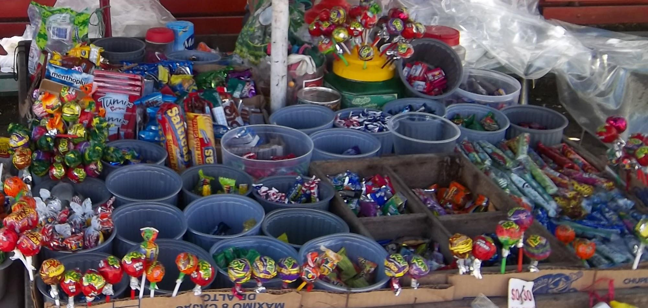
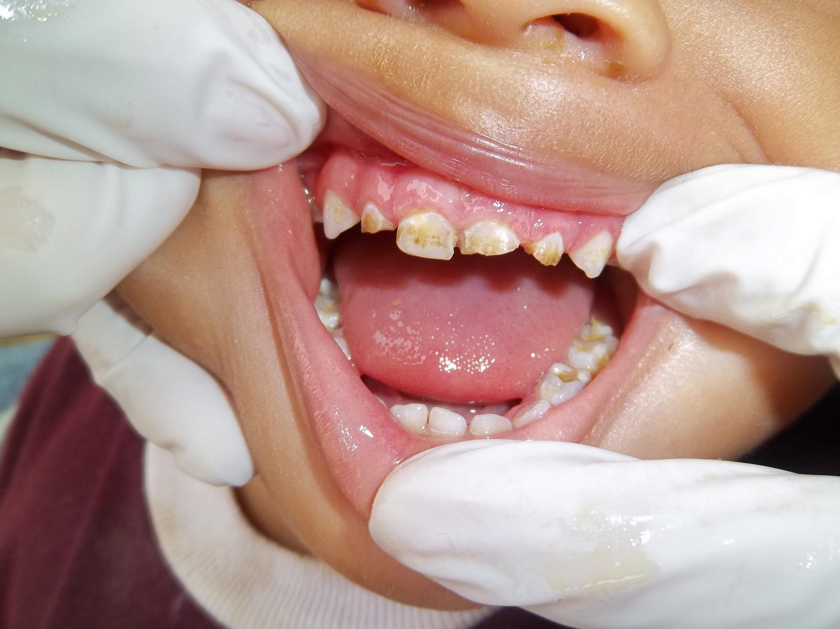


REMEMBER

Slide 18
Written by
The Children's Oral Health and Nutrition Program
University of California, Berkeley, School of Public Health
in collaboration with Kenya Smiles
A public health and children's dental care project of the Rotary Clubs of District 5160 in Northern California, USA; the Rotary Club of Karen-Nairobi, Kenya; District 9200/9212, East Africa; and District 6150 in Arkansas, USA: with generous participation of many partners and supporters in Kenya and the United States.
For more information visit our website at: www.kenyasmiles.org

